Slide 1
Collection Classes

Slide 2
Collection is a container that stores objects.
Collection classes are designed so that containing objects can be retrieved , added , manipulated efficiently.

Slide 3
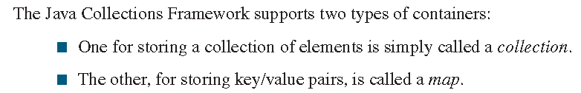
Java Collection Classes

Slide 4
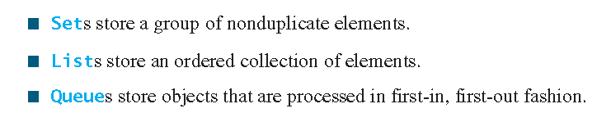
Collections Types

Slide 5
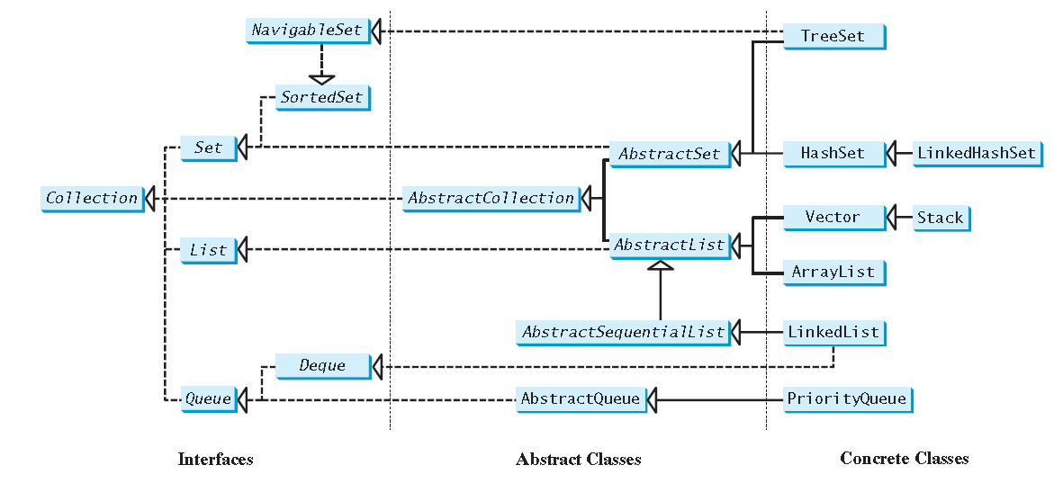

Slide 6
Collection Interface
The Collection interface is the root interface for manipulating a collection of objects.
Its public methods are listed in Figure

Slide 7
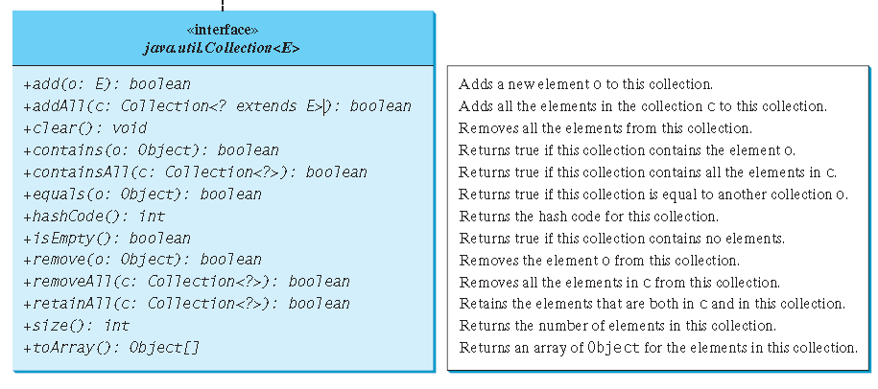

Slide 8
